Slide 1
CLASSIFICATION in MATLAB

Slide 2
Classification
Classification is a type of supervised machine learning in which an algorithm “learns” to classify new observations from examples of labeled data

Slide 3
Classification Tree / Decision Tree
Decision trees, or classification trees and regression trees, predict responses to data.
To predict a response, follow the decisions in the tree from the root (beginning) node down to a leaf node.
The leaf node contains the response.
Classification trees give responses that are nominal, such as 'true' or 'false'.
Regression trees give numeric responses.

Slide 4
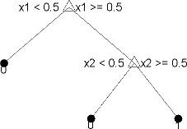
Each step in a prediction involves checking the value of one predictor (variable)
This tree predicts classifications based on two predictors, x1 and x2. To predict, start at the top node, represented by a triangle (Δ)

Slide 5
Train Classification Tree
tree = fitctree(Tbl,ResponseVarName)
tree = fitctree(Tbl,formula)
tree = fitctree(Tbl,Y)
tree = fitctree(X,Y)
tree = fitctree(___,Name,Value)

Slide 6
Train Classification Tree Create a classification tree using the entire ionosphere data set.
I/P code :
load ionosphere % Contains X and Y variables
Mdl = fitctree(X,Y)
O/P :
Mdl = ClassificationTree
ResponseName: 'Y'
CategoricalPredictors: []
ClassNames: {'b' 'g'}
ScoreTransform: 'none'
NumObservations: 351

Slide 7
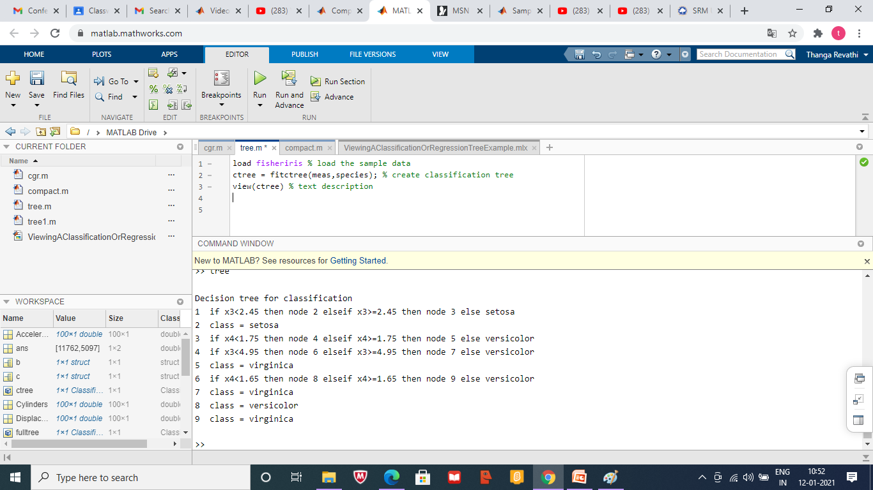

Slide 8
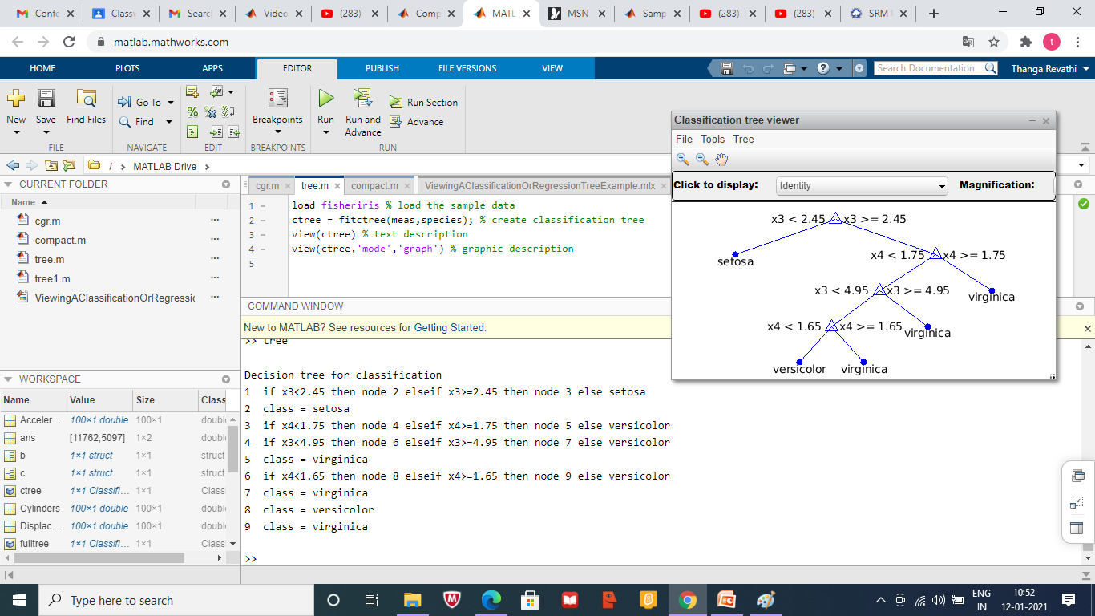

Slide 9
Compact Classification Tree
ctree = compact(tree)
creates a compact version of tree.

Slide 10
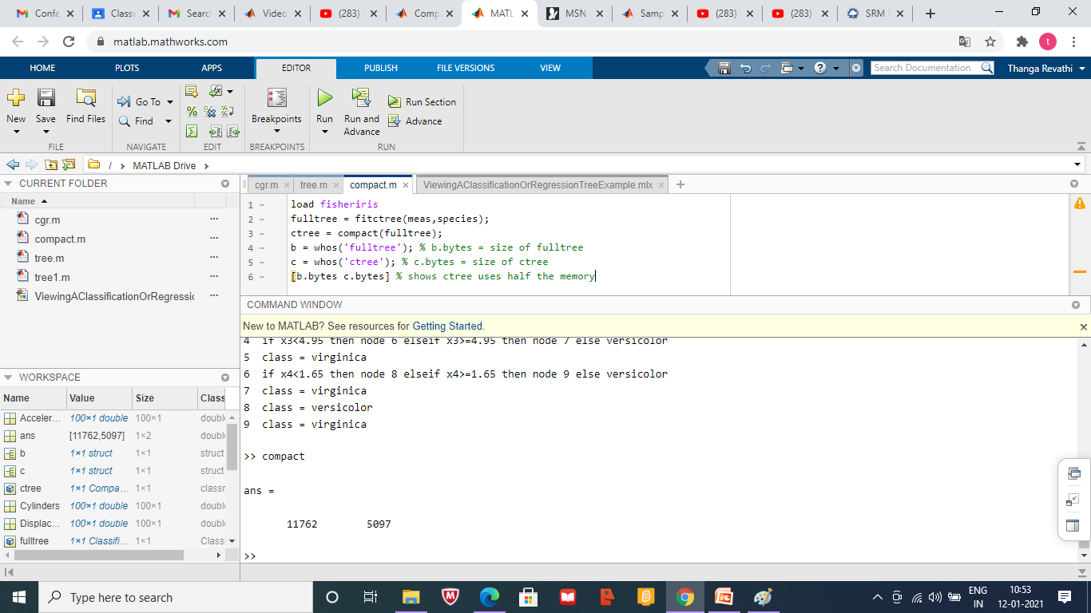

Slide 11
Train Regression Tree
tree = fitrtree(Tbl,ResponseVarName)
tree = fitrtree(Tbl,formula)
tree = fitrtree(Tbl,Y)
tree = fitrtree(X,Y)
tree = fitrtree(___,Name,Value)

Slide 12
Train Regression Tree
Create a regression tree using all observation in the carsmall data set.
Consider the Horsepower and Weight vectors as predictor variables, and the MPG vector as the response.

Slide 13
Train Regression Tree
I/P Code :
load carsmall % Contains Horsepower, Weight, MPG
X = [Horsepower Weight];
Mdl = fitrtree(X,MPG)

Slide 14
Train Regression Tree
O/P:
Mdl = RegressionTree
ResponseName: 'Y‘
CategoricalPredictors: []
ResponseTransform: 'none'
NumObservations: 94

Slide 15


Slide 16
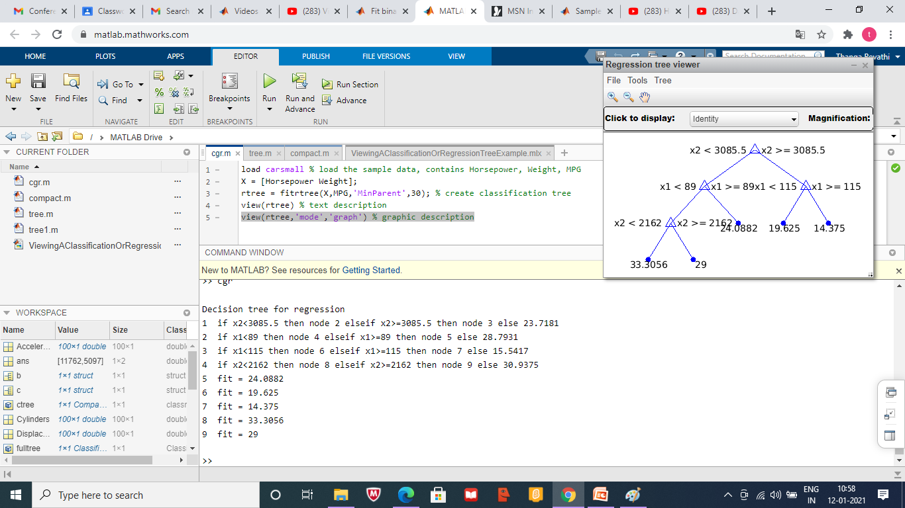

Slide 17
Sample Data set
https://in.mathworks.com/help/stats/sample-data-sets.html

Slide 18
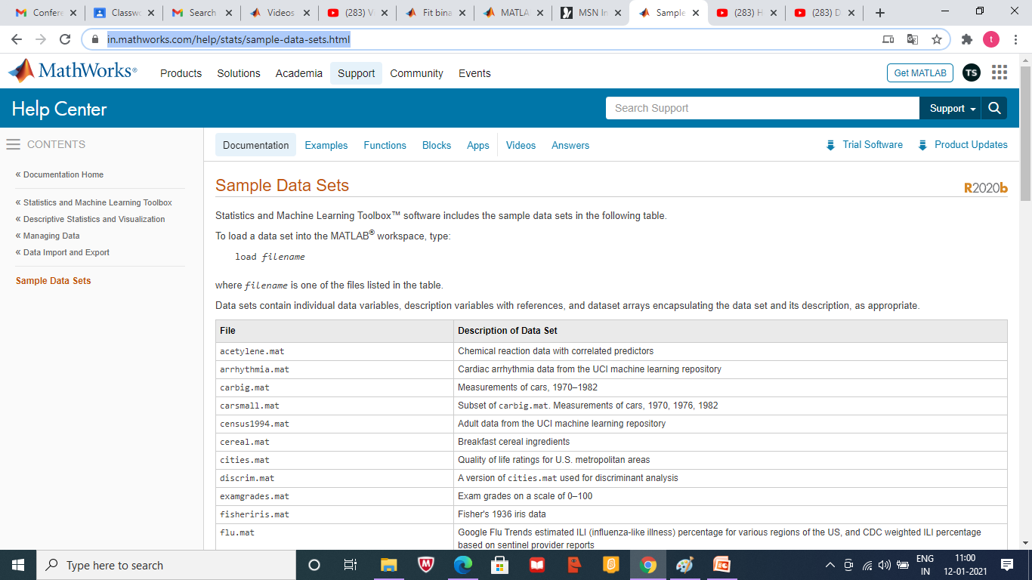

Slide 19
Heart Sound Classification
https://in.mathworks.com/videos/machine-learning-using-heart-sound-classification-example-1515709249154.html

Slide 20
https://www.youtube.com/watch?v=k4C4Ol1TD2w&list=PLjfRmoYoxpNoaZmR2OTVrh-72YzLZBlJ2&index=2

